Slide 1
Star Formation Efficiency Analysis of the Galaxy NGC 4826
Nathanael Mains, Dr. Paul Scowen, Kelley Liebst
Arizona State University

Slide 2
What is the
Star Formation Efficiency?
The star formation efficiency
(SFE) is the ratio of the star
formation rate (SFR) to
the total gas surface density.
This allows us to analyze how
much of the gas inside a galaxy is being formed into stars.

Slide 3
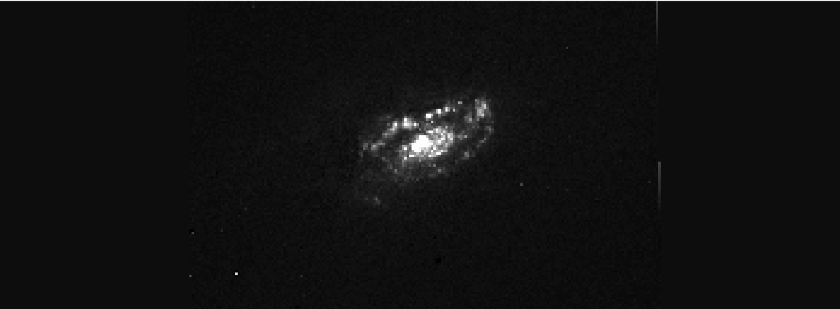

Star Formation Rate
The SFR is found by combining Hα optical emission and 24μm infrared (IR) emission.
Hα optical emission represents the current rate of recent star formation within a galaxy.
24μm IR emission is thermal emission from dust grains that have absorbed optical light from stars and reprocessed it as infrared emission.
Hα image of NGC 4826
24μm image of NGC 4826

Slide 4
Hα
24μm
Notes:
Labels
Check Scales (Make sure same size)

Slide 5
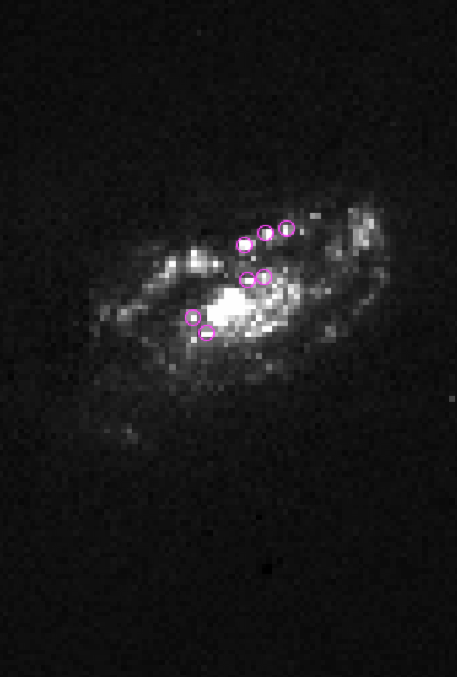

Hα
24μm

Slide 6


Hα
24μm

Slide 7
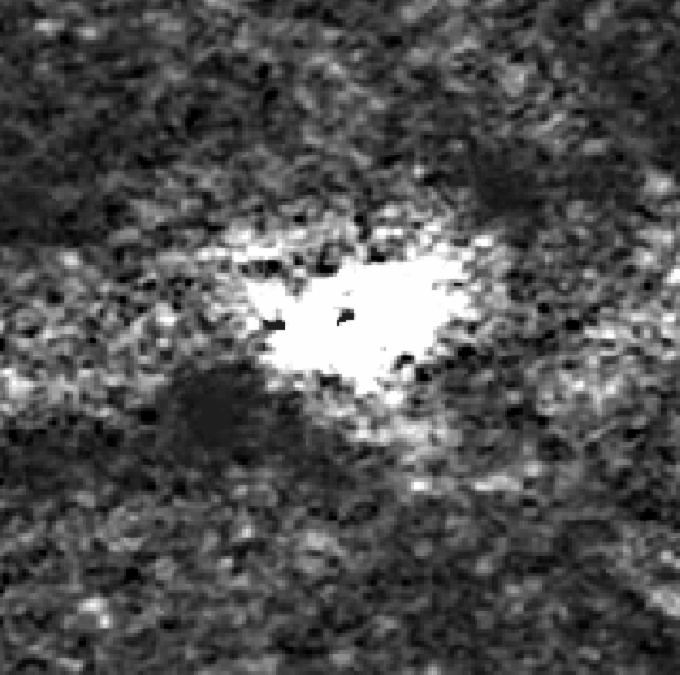

Gas Surface Density
The gas surface density is found by combining atomic (HI) and molecular hydrogen emission.
HI is particularly useful in calculating the total surface density of atomic gas because of its 21cm spin-flip transition.
Molecular hydrogen is the primary molecule inside of molecular clouds.
  We must use Carbon Monoxide (CO) in order to detect it.
HI image of NGC 4826
CO image of NGC 4826

Slide 8
Methodology
Measure the SFE on a pixel-by-pixel scale.
We calculate the SFR by using an empirical equation defined by Calzetti et al (2007).
We calculate the gas surface density using the empirical equation defined by Kennicutt et al (2007).

Slide 9
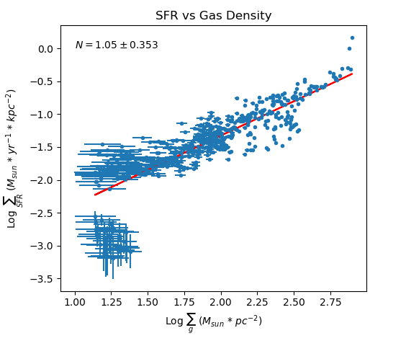
Results

Slide 10
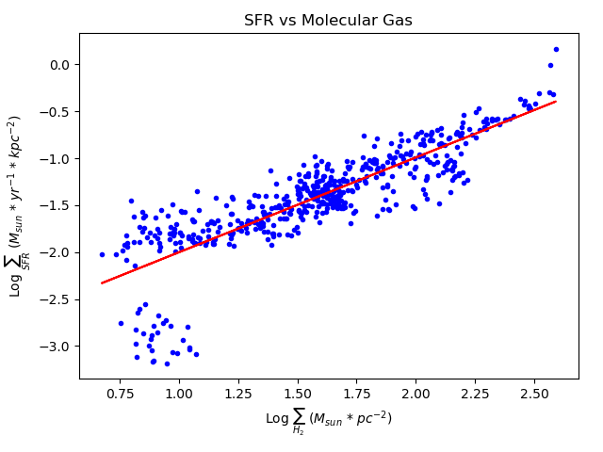
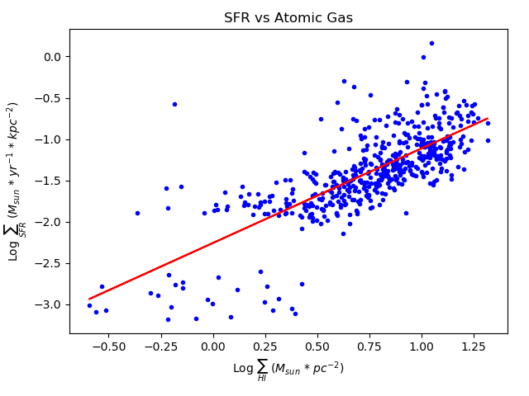
Future Work
Future work will focus on performing high spatial analyses on regions of interest within the SFE.
We will also plot the SFE and its distance from the center of the galaxy so that we can better understand where star forming events are occurring.
Notes:
Spatial Analysis
Plotting of the values of SFE vs the distance from center
Locate regions of interest within the SFE

Slide 11
References
Calzetti, D., et al. 2007, ApJ, 666, 870
Helfer, T. T., Thornley, M. D., Regan, M. W., Wong, T., Sheth, K., Vogel, S. N., Blitz, L., & Bock, D. C.-J. 2003, ApJS, 145, 259
Kennicutt, R. C., et al. 2003, PASP, 115, 928
Kennicutt, R. C., et al. 2008, ApJS, 178, 247K
Kennicutt, R.C., et al. 2007, ApJ, 671, 333
Walter, F., et al. 2008, AJ, 136, 2563

Slide 12
Acknowledgements
Support for this project came from the NASA/ASU Space Grant Consortium.
Thank you to Dr. Paul Scowen and Kelley Liebst for serving as mentors throughout this project.

Slide 13
Questions?

